Slide 1
http://www.vidyanidhi.com/
ketkiacharya.net@gmail.com
Ketki Acharya
From: SM VITA ATC of CDAC
9769201036
ketkiacharya.net@gmail.com

Slide 2
Enum
It is used when you want to give option to the user from the available list.
Data are stored as index(0 to --);
For eg name of department [ADMIN, ADV, MKT], generally departments in company are fixed through out the life of application. If we take name of department from user they tend to make spelling mistake or may enter invalid data. Programmer has to validate that data. To have better, faster and low maintenance of application we use enum. We can show enum data in dropdown list or we can ask user to enter number as internally enum are stored as (index )int, and programmer will assign legitimate value. If you assign invalid data it will be compile time error
enum is user define data type
User define enum is derived from Enum(abstract class) which is derived from Object class
Enum is value type data and resides on stack.

Slide 3
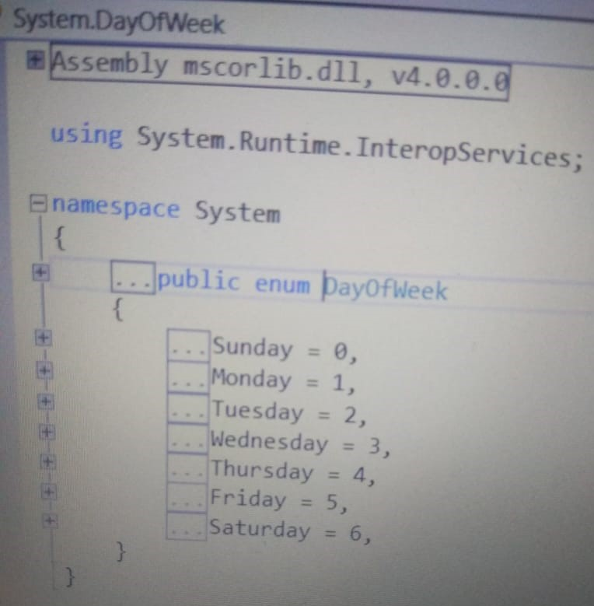
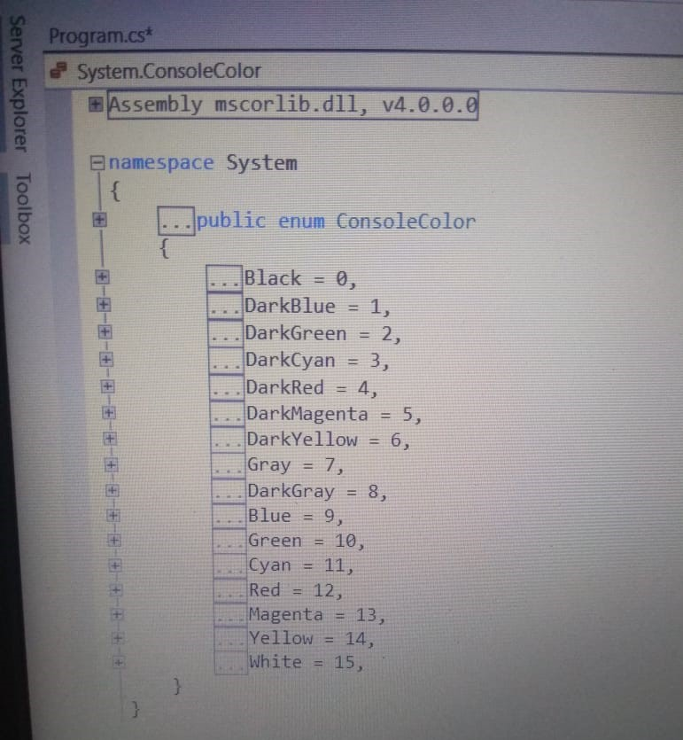
In dot net frame work following are predefine enum
enum DayOfWeek , enum ConsoleColor, enum FileAccess etc
In your code type enum DayOfWeek and right click on it and then click go to definition you will see the following screen

Slide 4
An enumeration can save you a lot of time and headaches in the long run.
1.Exist to using enumerations instead of plain integers
2.As mentioned, enumerations make your code easier to maintain by helping to ensure that your variables are assigned only legitimate, anticipated values.
3. Enumerations make your code clearer by allowing you to refer to integer values by descriptive names rather than by obscure “ magic ” numbers.
4. Enumerations make your code easier to type, too. When you go to assign a
value to an instance of an enumerated type, the Visual Studio .NET IDE will,
through IntelliSense, pop up a list box of acceptable values in order to save you
some keystrokes and to remind you of what the possible options are.
There are certain type of data which are fixed and for that there are no separate data type eg name of week, month, color , Mr-Miss-MRS etc

Slide 5
Some example where you can use enum
File open close indicator
Courses offered to students[DAC , DBDA]
In bank types of account[Saving, Current,FD],
In games- [X, O], [stone, paper , scissors]

Slide 6
using System;
namespace FunWithEnums
{
enum EmpType // A custom enumeration.
{
Manager, // = 0
Grunt, // = 1
Contractor, // = 2
VicePresident // = 3
}
class Program
{
static void Main(string[] args)
{
EmpType emp = EmpType.Contractor;
AskForBonus(emp);
// Prints out "emp is a Contractor".
Console.WriteLine("emp is a {0}.", emp.ToString());
// Prints out "Contractor = 2".
Console.WriteLine("{0} = {1}", emp.ToString(), (int)emp);
}
// Enums as parameters.
static void AskForBonus(EmpType e)
{
switch (e)
{
case EmpType.Manager:
Console.WriteLine("How about stock options instead?");
break;
case EmpType.Grunt:
Console.WriteLine("You have got to be kidding...");
break;
case EmpType.Contractor:
Console.WriteLine("You already get enough cash...");
break;
case EmpType.VicePresident:
Console.WriteLine("VERY GOOD, Sir!");
break;
}
}
}
}
Stack
Emp=Contractor
In the above example internally Manager will have index value 0 , Grunt -1 and so on.
We have declare enum out side class but you can declare within class also. See next example

Slide 7
Can I declare enum inside class ? yes
using System;
namespace ConsoleApplication1
{
public class myclass
{ public enum day { Monday, Tuesday }
}
class Program
{
static void Main(string[] args)
{
myclass obj = new myclass();
myclass.day d = myclass.day.Monday; //use classname .enum name
Console.WriteLine(d);
}
}
}

Slide 8
enum Day{
Sunday=1,
Monday,
Tuesday,
Wednesday,
Thursday,
Friday,
Saturday }
In this internal numerical value for Moday will be 2, Tuesday-3 ad so on
enum Dept{
ADV,
MKT,
ADMIN
}
In this internal numerical value of ADV will be 0, MKT-1 and ADMIN-2
enum Courses{
DAC,
DBDA=10,
VLSI,
EBEDED
}
What is internal numerical value for DAC?
Ans: 0
What is internal numerical value for VLSI?
Ans: 11
enum Courses{
DAC,
DBDA=0,
VLSI,
EBEDED
}
What is internal numerical value for DAC?
Ans: 0
What is internal numerical value for VLSI?
Ans: 1

Slide 9
Following question to be refer once you complete basic oops and array of object concept.
Create enum dep having value [MKT=1 , ADV=2,ADMN=3]
Create a class Employee with instance member id, name , salary and enum dept d.
Create 5 object of class Employee and put them into different department.
Write a sataic method which will display department wise total salary paid
E.g.
1, "Raj", 3000, dep.ADMN
2, "Reena", 2000, dep.ADMN
3, "Geeta", 1000, dep.MKT
O/p ADMN department spend 5000 on salary
MKT department spend 1000 on salary

Slide 10
using System;
namespace enumeration
{
enum dep
{ MKT=1 , ADV=2,ADMN=3
}
class Employee
{ //instance member
int id;
string name;
float salary;
dep d;
// constructor
public Employee(int i, string nm, float sal,dep dd)
{
id = i;
name = nm;
salary = sal;
d = dd;
}
public override string ToString()
{
return string.Format("{0}{1}{2}{3}", id, name, salary, d);
}
public static void deptwisesal(Employee []arr) // static method
{
float dm = 0, dadv = 0, dadmin = 0;
for (int i = 0; i < arr.Length; i++)
{
if(arr[i].d==dep.MKT )
dm=dm+arr[i].salary;
else if(arr[i].d==dep.ADV )
dadv=dadv+arr[i].salary;
else if(arr[i].d==dep.ADMN )
dadmin = dadmin + arr[i].salary;
}
Console.WriteLine("MKT={0}ADV={1}ADMIN={2}", dm, dadv, dadmin);
}
}
class Program
{
static void Main(string[] args)
{
Employee e1 = new Employee(1, "Raj", 3000, dep.ADMN);
Employee e2 = new Employee(2, "Reena", 2000, dep.ADMN);
Employee e3 = new Employee(3, "Geeta", 1000, dep.MKT);
Console.WriteLine(e1);
Employee[] arr = new Employee[3];
arr[0] = e1;
arr[1]=e2;
arr[2] = e3;
Employee.deptwisesal(arr);
Console.ReadLine();
}
}
}

